Slide 1
Time-Series and Spatial/Temporal Sequences

Slide 2


Time Series Data
Data Object: growth chart, stock price over time, battery life over time
Attribute: the measurement of a (numerical) property observed at a given time point
👶: 2y 3y 4y 5y 6y
height (in): 34 38 41 43 46
Emojis - Twitter - https://twemoji.twitter.com/ - CC-BY-4.0

Slide 3
The Time Series Representation
A list of timestamped measurements:
x_{i} is the (numerical) measurement of a property of X observed at time stamp t_{i}

Slide 4
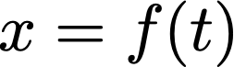
The Time Series Representation
A list of timestamped measurements:
x_{i} is the (numerical) measurement of a property of X observed at time stamp t_{i}
Alternative representation:

Slide 5
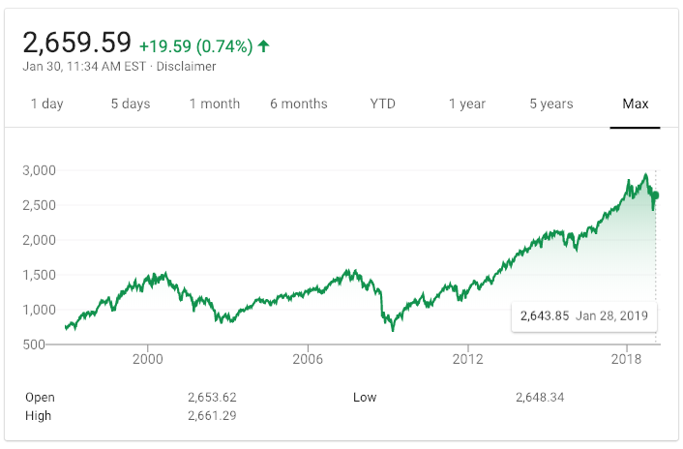
Examples of Time Series
Stock Market (SP 500)

Slide 6
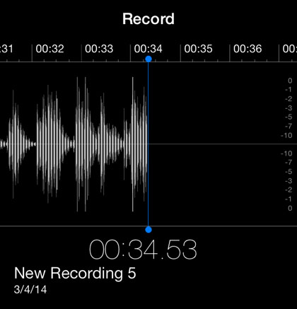
Examples of Time Series
Stock Market (SP 500)
Voice / Speech data

Slide 7
Spatial/Spatiotemporal Data
Data Object: GPS trajectory of a vehicle, spread of a disease, a heat map
Attribute: measurement of a (numerical) property at a given location is spatial data.
If measurement also includes a given time point, it is spatiotemporal data.

Slide 8
Spatial/Spatiotemporal Data
100BC Rome Athens Capua
population (k): 700 150 100
Location can be:
1D = just name of location
2D = longitude and latitude
3D = longitude, latitude, altitude

Slide 9
The Spatial/Spatiotemporal Representation
List of location-labeled measurements (2D):
longitude
latitude

Slide 10
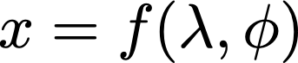
The Spatial/Spatiotemporal Representation
List of location-labeled measurements (2D):
Alternative Representation (2D):
longitude
latitude

Slide 11
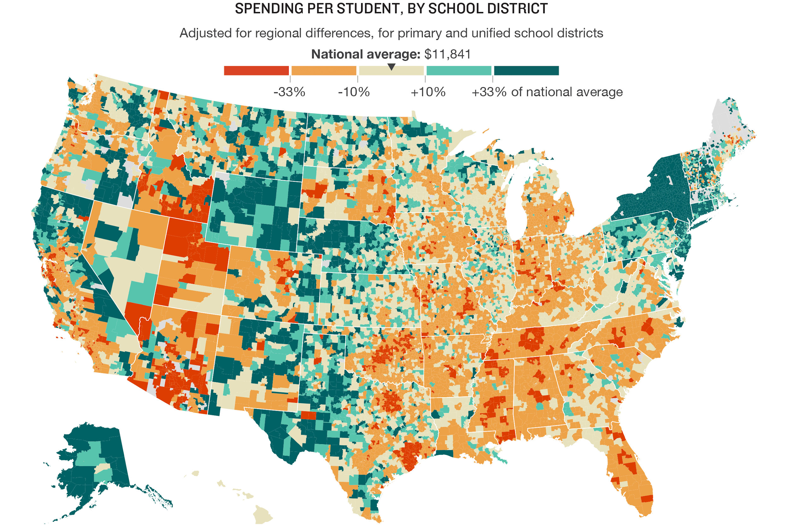
Examples of Spatial Data
Image Source: https://www.npr.org/2016/04/18/474256366/why-americas-schools-have-a-money-problem
Notes:
On the left:
On the right: a search engine result page heat map in 2005.

Slide 12
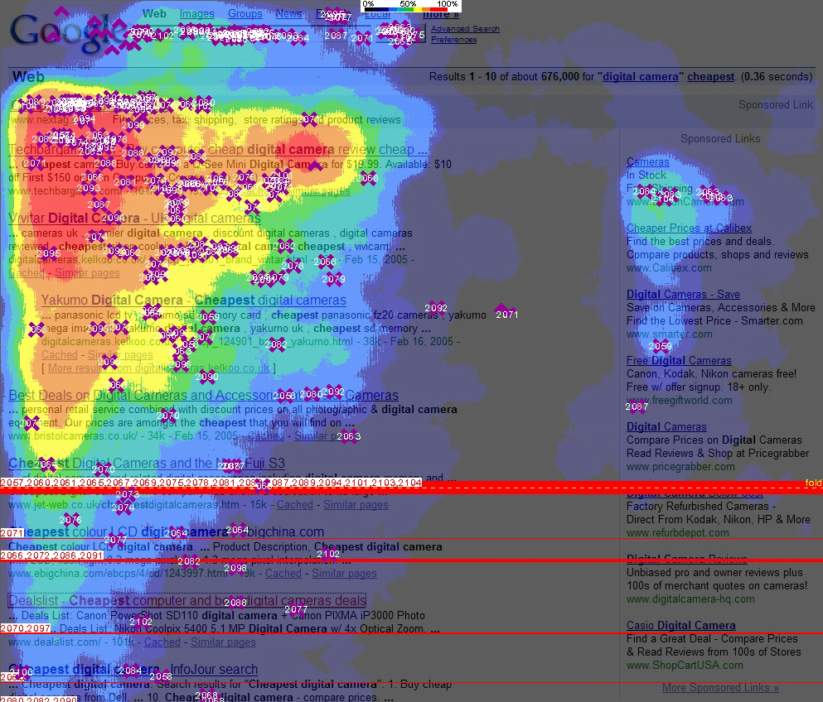
Examples of Spatial Data
Average time users’ eyes are fixed at locations on a Web page.
Locations are indicated by horizontal (X) and vertical (Y) positions.
Notes:
On the left:
On the right: a search engine result page heat map in 2005.

Slide 13
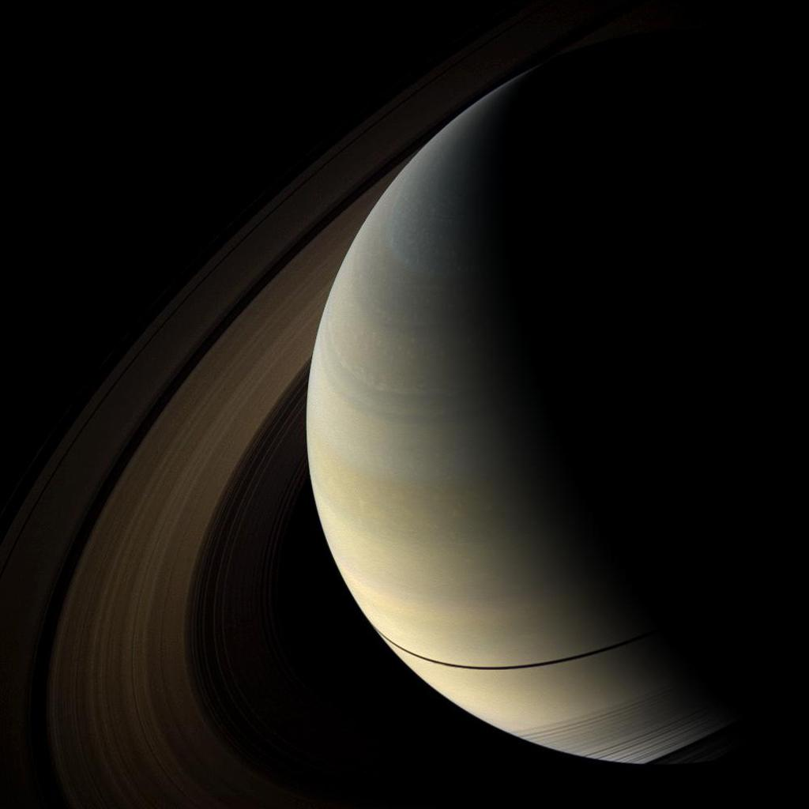
Examples of Spatial Data
1000 x 1000 px image:
X: 460
Y: 137
RGB values:
R: 151
G: 149
B: 138
source: https://www.jpl.nasa.gov/spaceimages/details.php?id=pia12708
Notes:
On the left:
On the right: a search engine result page heat map in 2005.

Slide 14
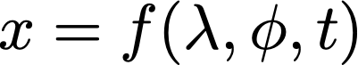
Spatiotemporal Data
Simply add the time dimension to a spatial representation to describe spatiotemporal data.

Slide 15
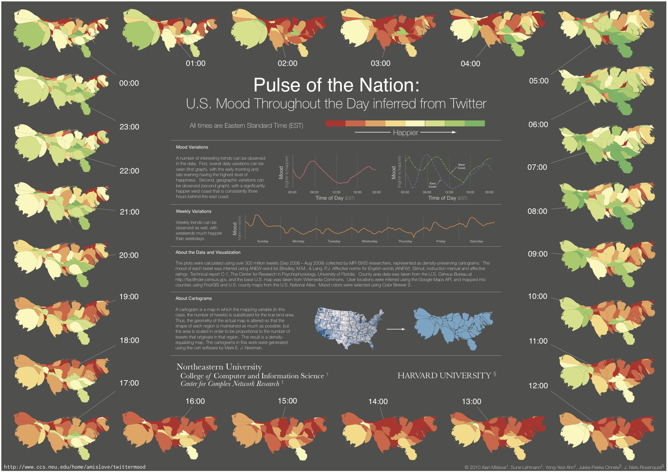
Example of Spatiotemporal Data
Pulse of the Nation - Alan Mislove, Sune Lehmann, Yong-Yeol Ahn, Jukka-Pekka Onnela, J. Niels Rosenquist - https://mislove.org/twittermood/ - CC BY 3.0

Slide 16


School of Information, University of Michigan
Qiaozhu Mei
School of Information
All Content © Presenter

